Slide 1
MS-700 Surface Duo (Android dual screen device) with Microsoft Teams!

Slide 2
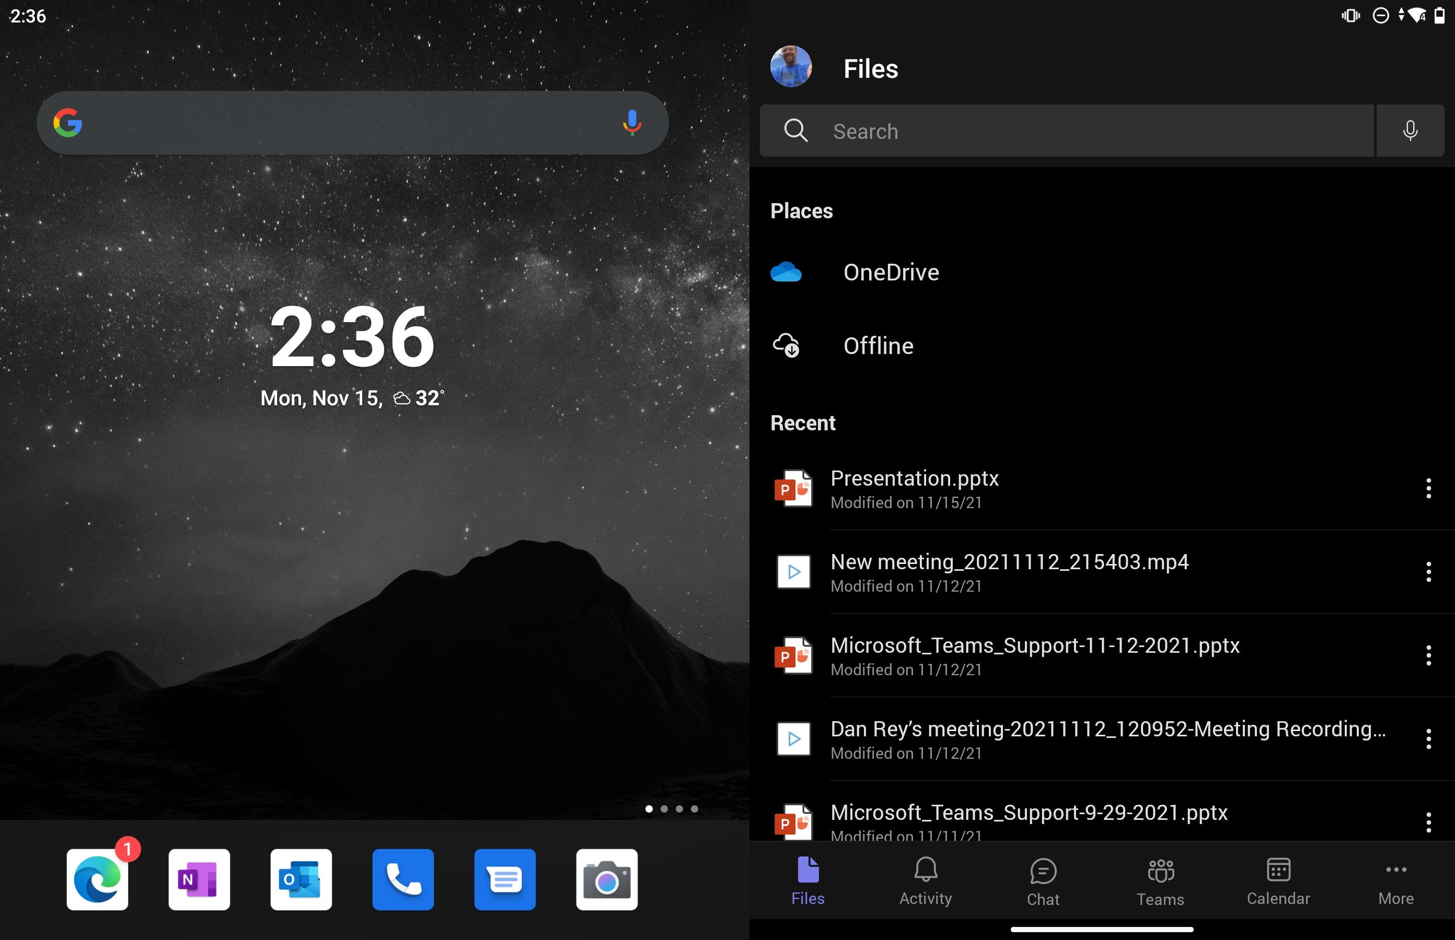
Surface Duo (Android OS - Dual Screen)

Slide 3
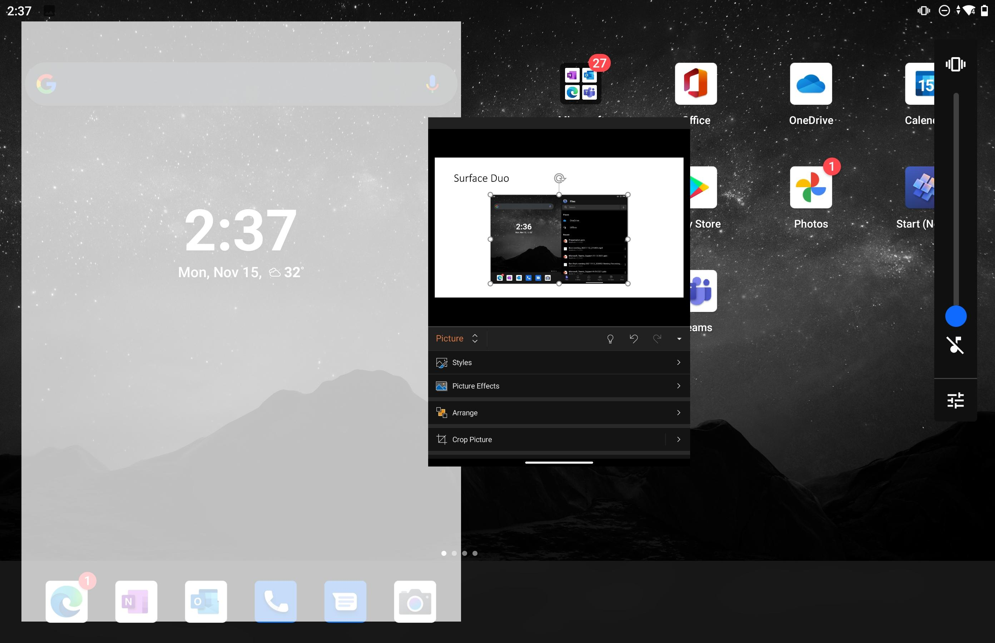
Teams can run on either side!

Slide 4
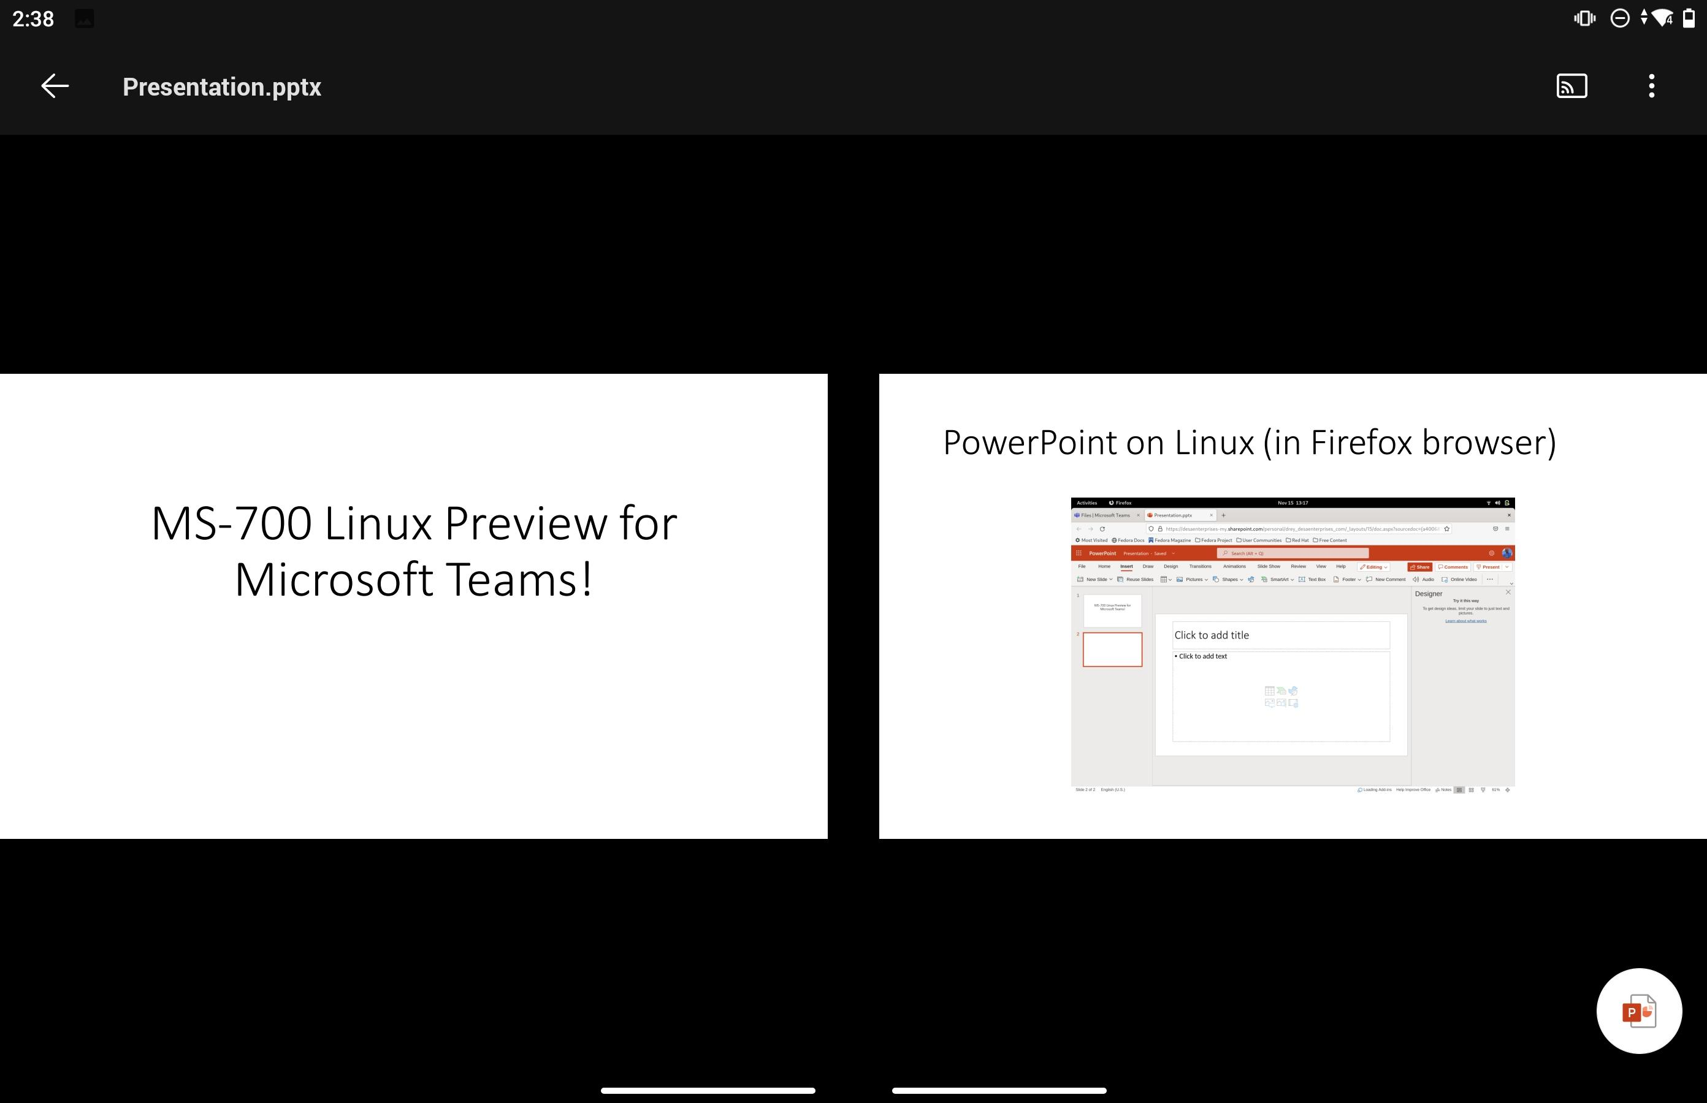
Teams can also span both screens!

Slide 5
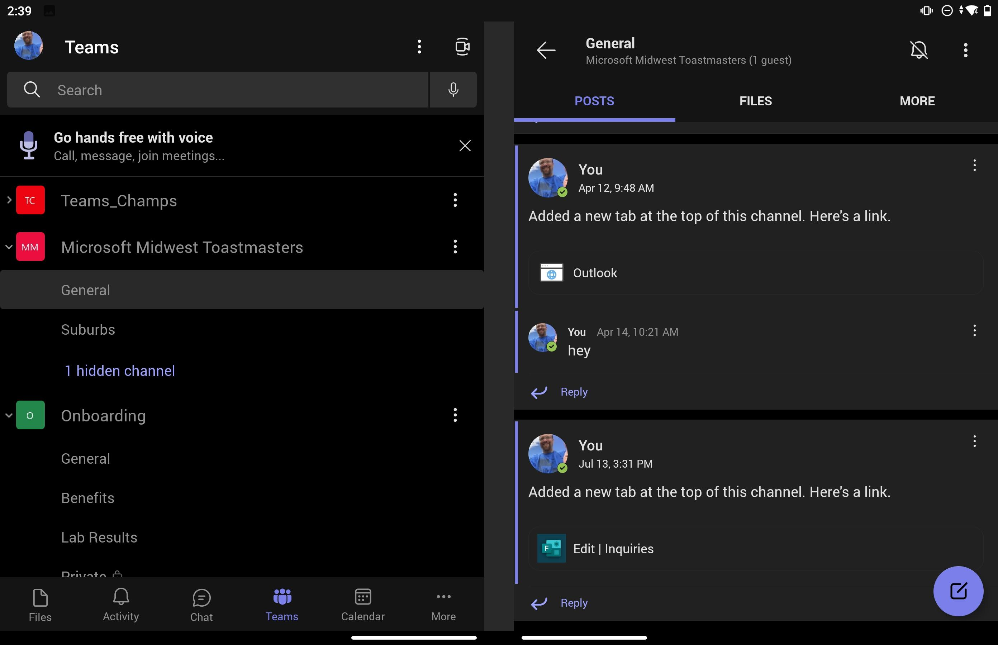
Teams Channel on left – channel details on right!

Slide 6
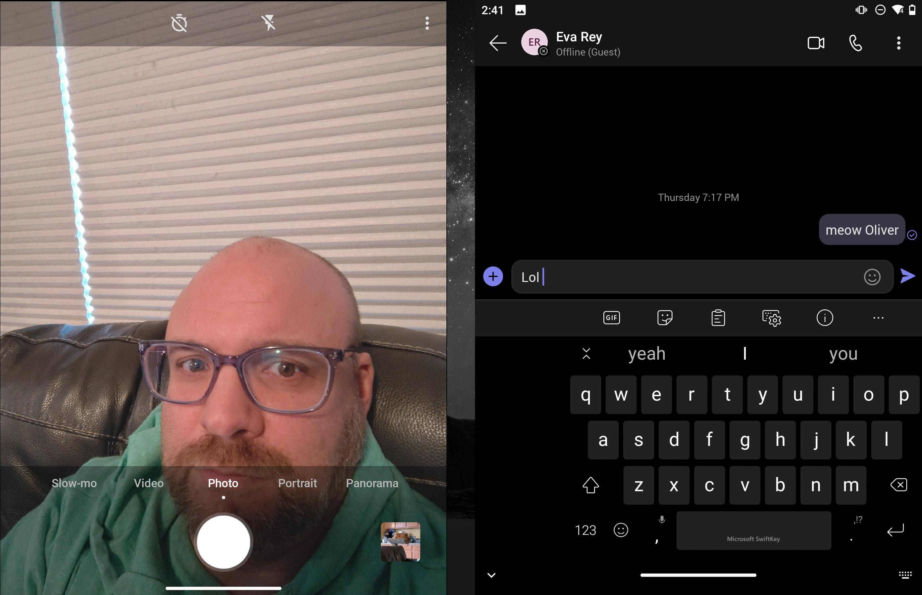
Camera and Teams

Slide 7

New Surface Duo 2 has dual cameras (one on either side) - original version only had 1 camera)

Slide 8
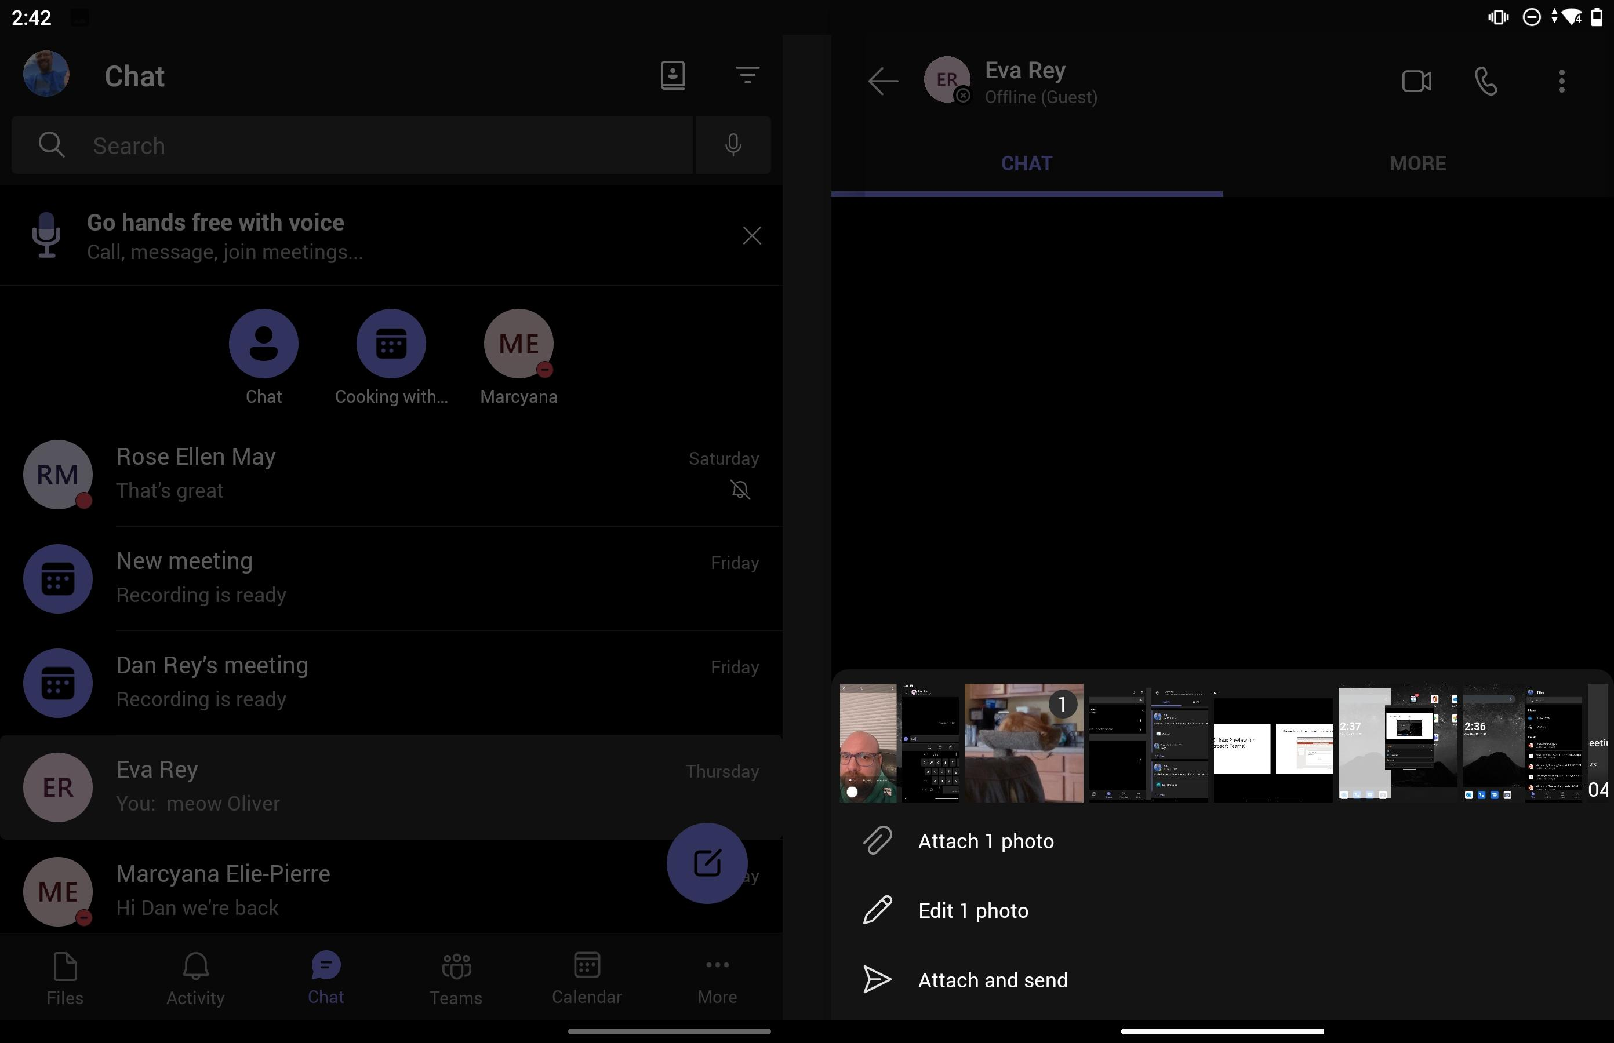
Teams Chat history on left – individual chat on right

Slide 9
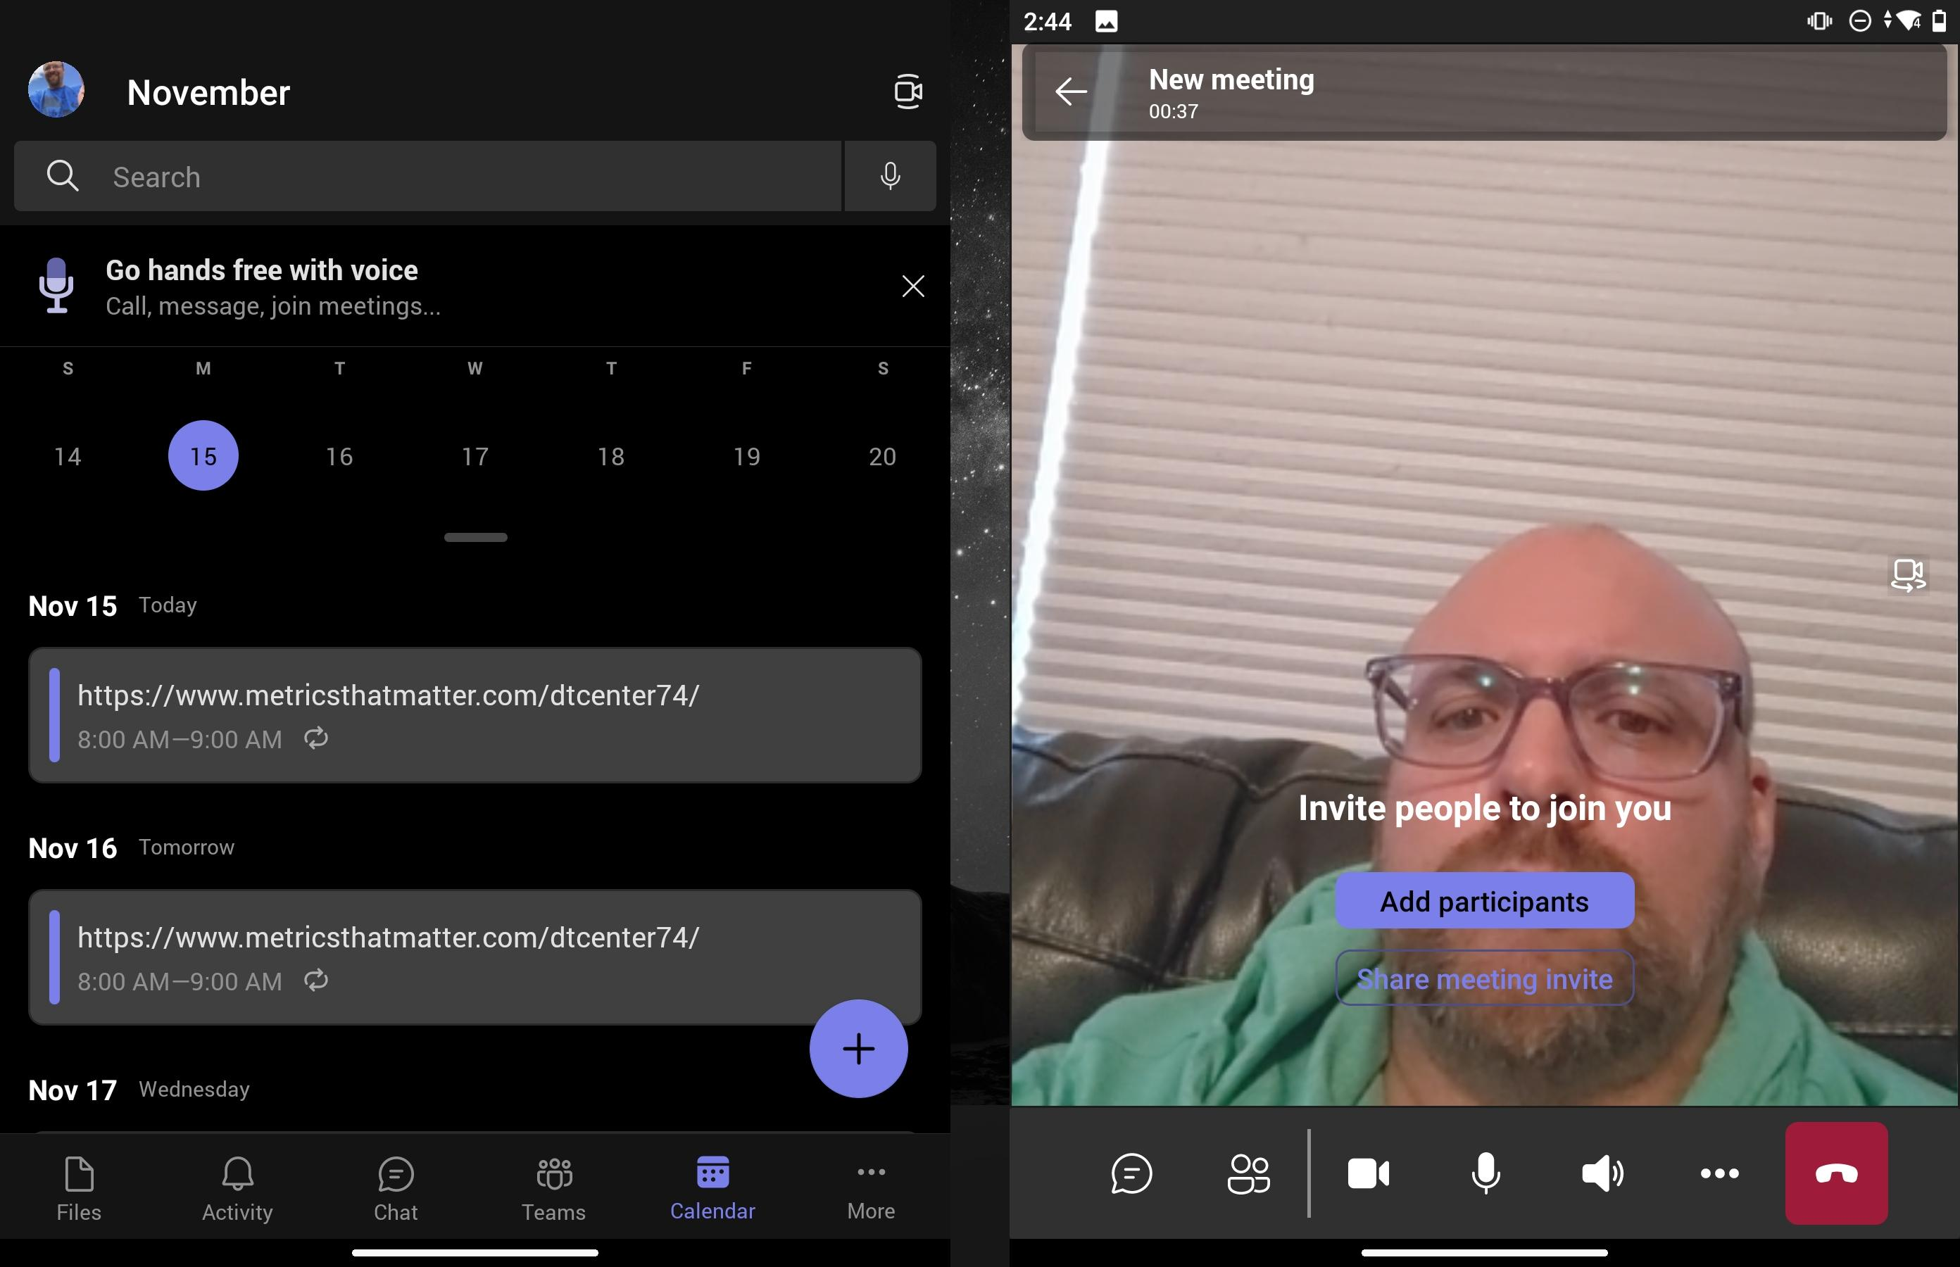
Teams Calendar on Left – Meeting on Right

